Slide 1

ABE 715
Computer Programming
Lecture 7: Data Analysis with NumPy & Pandas
Processing Sensor Data & Engineering Datasets
Dr. Kadeghe G. Fue
Department of Agricultural Engineering
1

Slide 2
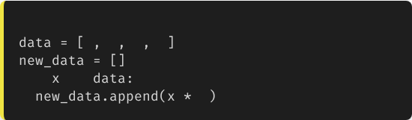

Recap: Why Lists Aren't Enough
Python Lists are flexible, but slow for math.
If you want to multiply every item in a list by 2, you have to write a loop.
# The "Slow" Way
1
2
3
4
for
in
Problem: In engineering, we deal with millions of data points (satellite imagery, weather stations). Loops are too slow!
2
2

Slide 3

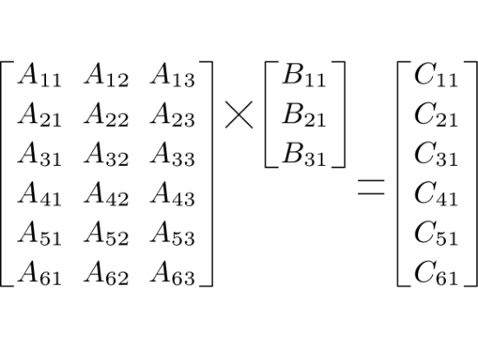
NumPy: Numerical Python
The Power of Vectorization
NumPy introduces the Array.
Arrays act like vectors/matrices in math. You can multiply entire arrays instantly without writing a loop.
•
Faster: Written in C, optimized for speed.
•
Memory Efficient: Uses less RAM than lists.
3

Slide 4
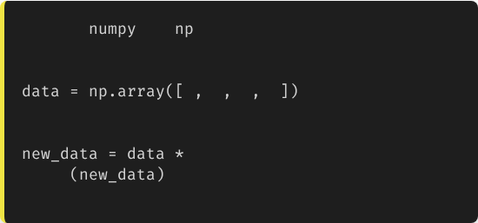
NumPy in Action
import
as
# Create an array
We import it as np (standard convention).
1
2
3
4
Notice how cleaner the math becomes.
# Vectorized Math
2
print
# Output: [2 4 6 8]
4

Slide 5

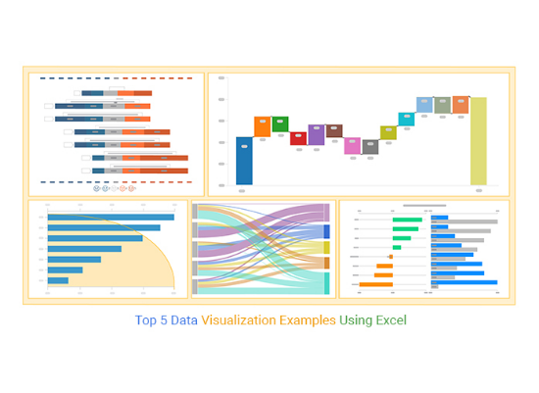
Pandas: Python Data Analysis
"Excel for Python"
While NumPy handles raw numbers, Pandas handles Tabular Data.
The core structure is the DataFrame.
•
Has named columns (e.g., "Temperature", "Humidity").
•
Handles missing data (NaN) gracefully.
•
Great for Time Series (Dates).
5

Slide 6
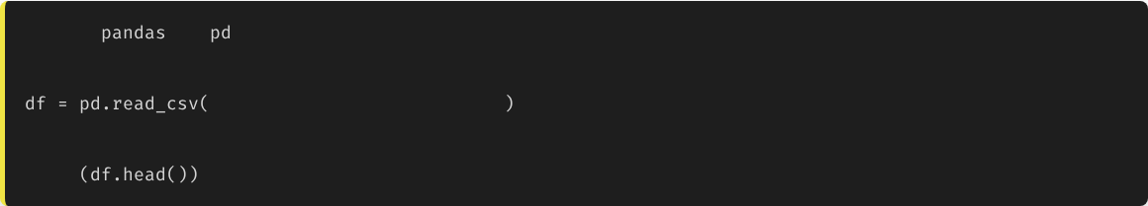
Loading Data
In Ag Engineering, data comes in CSV or Excel files. Pandas loads them in one line.
import
as
# Load a CSV file from a weather station
"morogoro_weather_2024.csv"
# View the first 5 rows
print
Date | Temp_Max | Temp_Min | Rainfall_mm
2024-01-01 | 32.5 | 21.0 | 0.0
2024-01-02 | 31.8 | 22.1 | 5.2
6

Slide 7


Inspecting the Dataset
.info()
.describe()
.shape
Shows data types and missing values.
Is "Rainfall" a number or text?
Instant statistics summary.
Dimensions of the data.
Count, Mean, Std Dev, Min, Max for all columns.
(Rows, Columns)
7

Slide 8
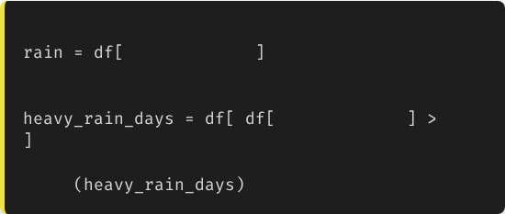
Filtering & Selection
Querying the Data
# Select a single column
"Rainfall_mm"
We can filter rows based on conditions, just like SQL or Excel filters.
# Filter rows
"Rainfall_mm"
10
Example: Find all days where rainfall exceeded 10mm.
print
8

Slide 9
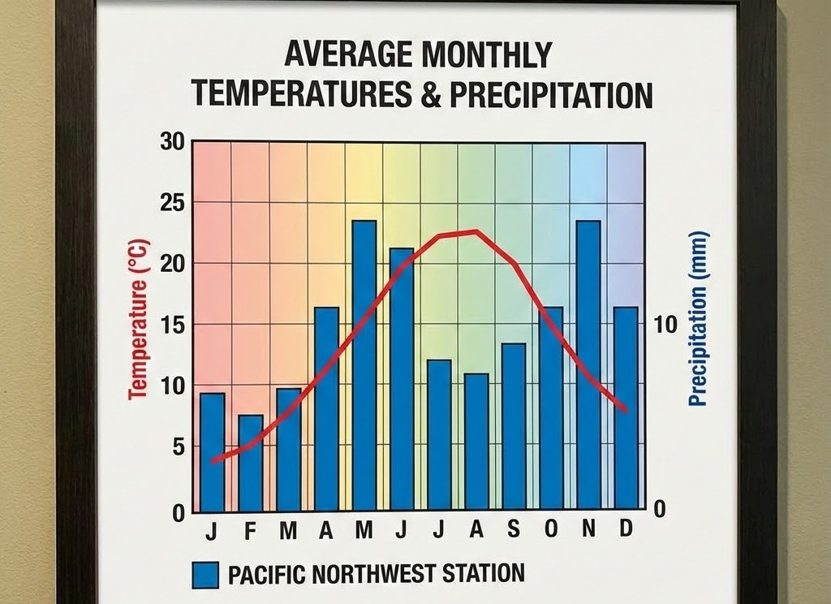
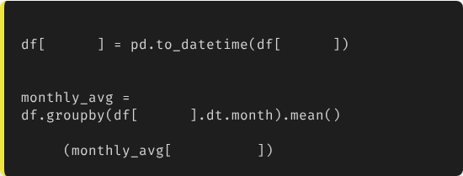
Case 1: Climate Analysis
Monthly Averages
We need to calculate the average monthly max temperature for irrigation planning.
# Convert date column to Datetime objects
"Date"
"Date"
# Group by Month and calculate Mean
"Date"
print
"Temp_Max"
9

Slide 10
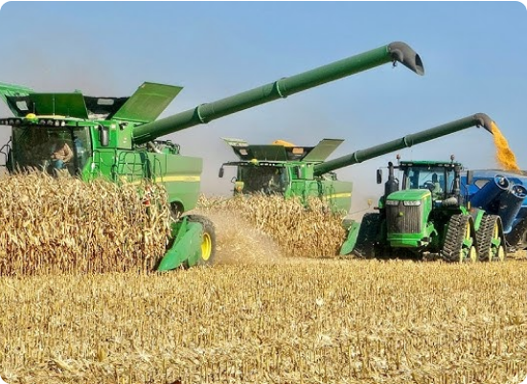
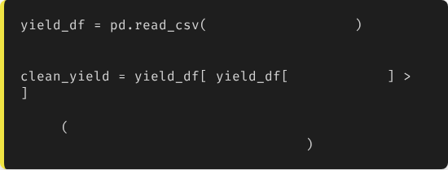
Case 2: Yield Analysis
Cleaning Noisy Data
Yield monitors often record "0" values when the harvester turns around. We must remove these to get accurate averages.
"harvest_data.csv"
# Remove zeros
"Yield_t_ha"
0
print
f"Avg Yield: {clean_yield['Yield_t_ha'].mean()}"
10

Slide 11





Data Cleaning Essentials
.dropna()
.fillna(0)
.drop_duplicates()
Removes any row containing missing values (NaN).
Replaces missing values with a specific number (e.g., 0).
Removes identical rows (common in sensor glitches).
11

Slide 12

Lecture 7: Take-Home Assignment
Weather Data Analyst
Task: You are provided with a CSV file sua_weather.csv containing 365 days of data (Columns: 'Date', 'Rain', 'Temp').
Write a Pandas script to:
1.
Load the CSV.
2.
Calculate the Total Annual Rainfall (Sum).
3.
Find the hottest day of the year (Max Temp) and print the date.
4.
Create a new DataFrame containing only days where it rained (Rain > 0).
5.
Save this new filtered data to rainy_days.csv using .to_csv().
12

Slide 13
Questions?
Next Class: Data Visualization (Matplotlib & Seaborn)
Dr. Kadeghe G. Fue
Department of Agricultural Engineering
13

